Slide 1
“Primum Non Nocere”
Above All, Do No Harm
Adjuvant Radiotherapy for Endometrial Cancer
Mansoor Raza Mirza, MD
Rigshospitalet
Copenhagen, Denmark

Slide 2
“Primum Non Nocere”
I Am a Medical & Radiation Oncologist

Slide 3
Bertrand Russell author, mathematician, & philosopher (1872–1970) Nobel Prize Laureate
“Primum Non Nocere”
“In all affairs it’s a healthy thing now and then to hang a question mark on the things you have long taken for granted.”

Slide 4
Need for level one evidence Adjuvant external beam radiation therapy (EBRT) / brachytherapy Adjuvant EBRT + chemotherapy Conclusions
“Primum Non Nocere”

Slide 5
“Primum Non Nocere”
Why Level One Evidence Is Important?

Slide 6
Phase II Trial in Ovarian Cancer With Gemcitabine Results: 100% response rate
“Primum Non Nocere”
Ovarian cancer
Carboplatin + paclitaxel
+ gemcitabine
Hansen SW, et al. Ann Oncol. 1999;10 Suppl 1:51-53.

Slide 7
“Primum Non Nocere”
First-Line Phase III Trials in Ovarian Cancer Addition of Third Drug - Gemcitabine
Carboplatin + paclitaxel
Ovarian cancer
Carboplatin + paclitaxel
+ gemcitabine
Agent | No. of studies | Design | Status
Gemcitabine | 2 1 | Triplet Sequential doublet | NEGATIVE
Bookman MA, et al. J Clin Oncol. 2009;27(9):1419-1425. Herrstedt J, et al. J Clin Oncol. 2009;27(32):5363-5369.

Slide 8
Need for level one evidence Adjuvant EBRT / brachytherapy Adjuvant EBRT + chemotherapy Conclusions
“Primum Non Nocere”

Slide 9
“Primum Non Nocere”
Level One Evidence for Adjuvant Radiotherapy in Endometrial Cancer?

Slide 10
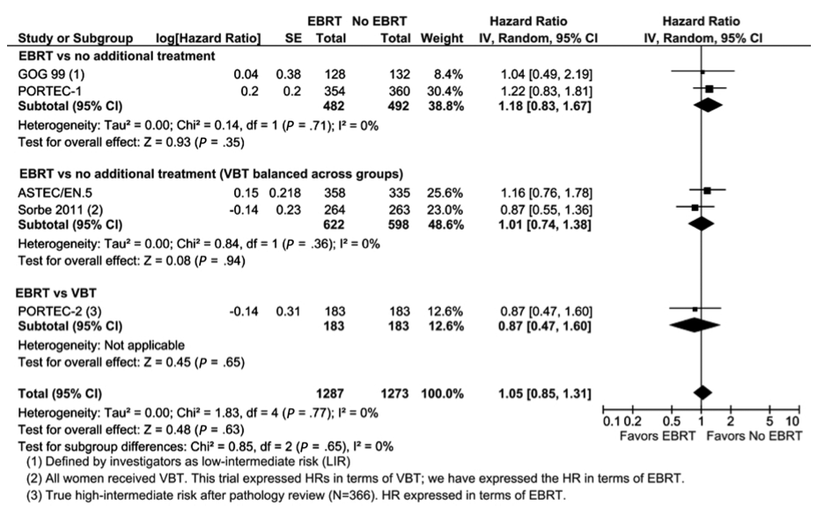
Cochrane Meta-Analysis of 8 Clinical Trials (n = 3628) Aalders; ASTEC; GOG99; PORTEC1; PORTEC2; Soderini2003; Sorbe2009; Sorbe 2011
“Primum Non Nocere”
Overall Survival
Kong A, et al. J Natl Cancer Inst. 2012;104(21):1625-1634.
Aalders J, et al. Obstet Gynecol. 1980;56(4):419-427. Soderini A, et al. Int J Gynecol Cancer. 2003;13(suppl 1): Abstract P0147:78. Sorbe B, et al. Int J Gynecol Cancer. 2009;19(5):873-878. Sorbe B, et al. Int J Radiat Oncol Biol Phys. 2012 82(3):1249-1255.

Slide 11
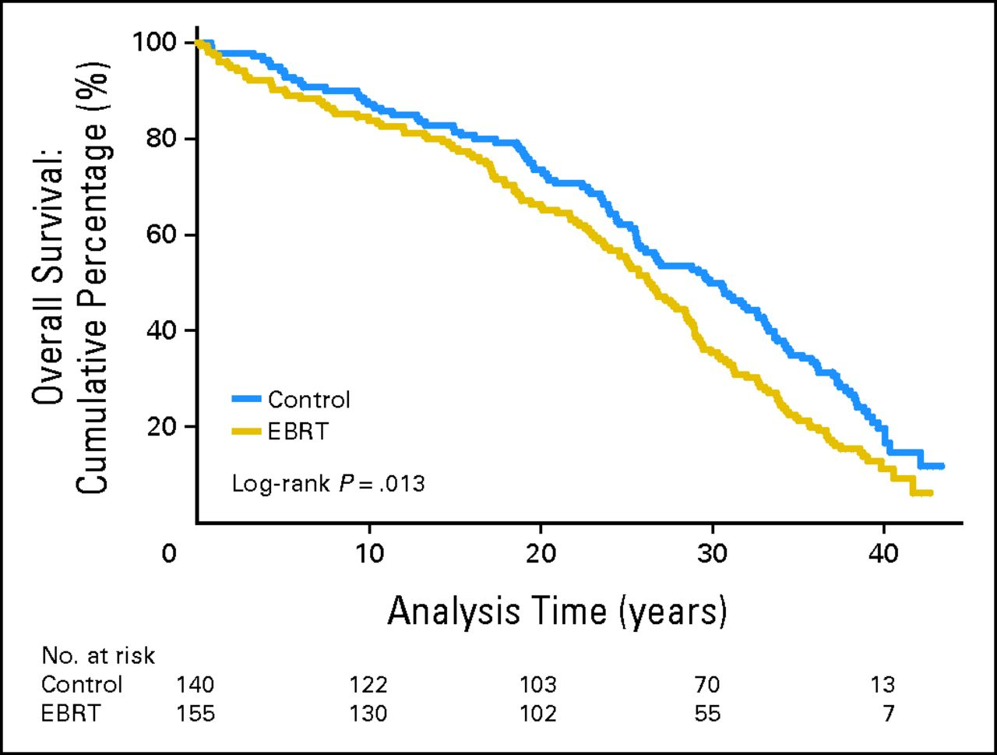
“Primum Non Nocere”
Long Term Outcomes After EBRT for Early Stage Endometrial Cancer, Oslo Trial – Revisited!
Overall survival in patients <60 years, intent-to-treat
Onsrud M, et al. J Clin Oncol. 2013;31(31):3951-3956.

Slide 12
Cochrane Meta-Analysis Long-Term Follow-Up
“Primum Non Nocere”
Radiotherapy deteriorates overall survival
PORTEC 1 & Aalders
HR = 1.26; CI = 1.03-1.54
Kong A, et al. J Natl Cancer Inst. 2012;104(21):1625-1634.

Slide 13
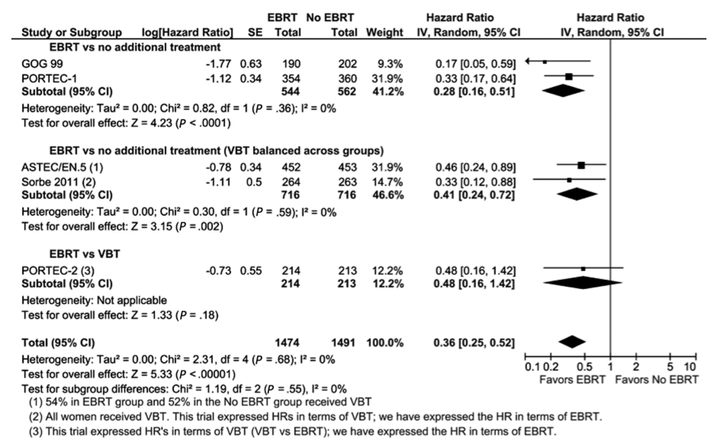
Cochrane Meta-Analysis Locoregional Control
“Primum Non Nocere”
Kong A, et al. J Natl Cancer Inst. 2012;104(21):1625-1634.

Slide 14
Cochrane Meta-Analysis Toxicity & QoL
“Primum Non Nocere”
Acute grade 3-4 (5) toxicity
2 trials; n = 1328; HR = 4.68; CI = 1.35-16.16
Fatal complications: 4
Late grade 3-4 toxicity
6 trials; n = 3501; HR = 2.58; CI = 1.61-4.11
Deteriorated quality of life
Urinary incontinence, diarrhea, fecal leakage, limited daily activities
Worsened physical functioning
Bodily pain
Kong A, et al. J Natl Cancer Inst. 2012;104(21):1625-1634.

Slide 15
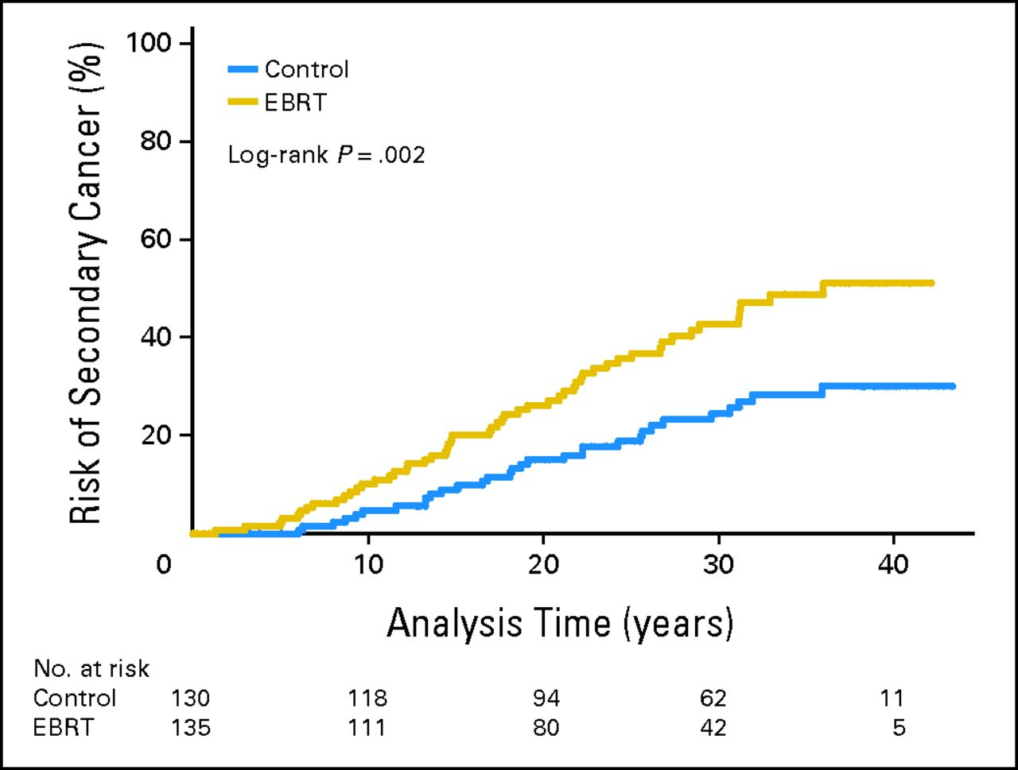
Risk of Secondary Cancer
“Primum Non Nocere”
Risk of secondary cancer in women younger than 60 years at treatment
Univariate Cox regression HR: 1.99 (95% CI: 1.27-3.10)
Onsrud M, et al. J Clin Oncol. 2013;31(31):3951-3956.

Slide 16
“Primum Non Nocere”
Stage I: Low-Risk Women Increase Risk of Endometrial Cancer-Related Death
 | Grade I | Grade II | Grade III | Serous/ clear cell
IA | - | - | + | +
IB | - | - | + | +
IC | + | + | + | +
IIA | + | + | + | +
HR: 2.64 (95% CI: 1.05 – 6.66)
Kong A, et al. J Natl Cancer Inst. 2012;104(21):1625-1634.

Slide 17
“Primum Non Nocere”
Stage I: Intermediate-Risk Women
No Benefit in Survival
 | Grade I | Grade II | Grade III | Serous/ clear cell
IA | - | - | - | +
IB | - | - | - | +
IC | - | - | + | +
IIA | + | + | + | +
HR: 1.05 (95% CI: 0.85 – 1.31)
Kong A, et al. J Natl Cancer Inst. 2012;104(21):1625-1634.

Slide 18
“Primum Non Nocere”
Stage I: High-Risk Women
No Benefit in Survival
 | Grade I | Grade II | Grade III | Serous/ clear cell
IA | - | - | - | -
IB | - | - | - | -
IC | - | - | - | -
IIA | - | - | - | -
HR: 0.91 (95% CI: 0.60 – 1.39)
Kong A, et al. J Natl Cancer Inst. 2012;104(21):1625-1634.

Slide 19
Bertrand Russell author, mathematician, & philosopher (1872–1970) Nobel Prize Laureate
“Primum Non Nocere”
Interpretation of a Radiotherapist
“If a man radiotherapist is offered a fact which goes against his instincts, he will scrutinize it closely, and unless the evidence is overwhelming, he will refuse to believe it.
If, on the other hand, he is offered something which affords a reason for acting in accordance to his instincts, he will accept it even on the slightest evidence. The origin of myths is explained in this way.”

Slide 20
“Primum Non Nocere”
PORTEC-2
FIGO stage I
Medium risk patients
(n = 715)
5-year actuarial percentages
 | EBRT | VBT
Vaginal relapse | 2% | 1% | P<.001
Overall survival | 81% | 85% | P = .31
EBRT
(n = 354)
Hysterectomy
Vaginal brachytherapy (VBT)
(n = 361)
Nout RA, et al. J Clin Oncol. 2009;27(21):3547-3556.

Slide 21
“Primum Non Nocere”
Local Control
100 patients
^{Adjuvant}
^{EBRT/VBT}
98-99 1-2
Vaginal Vaginal
control relapse

Slide 22
“Primum Non Nocere”
Local Control
100 patients
No adjuvant
EBRT/VBT
90 10
Vaginal Vaginal
control relapse
100 patients
Adjuvant
EBRT/VBT
98-99 1-2
Vaginal Vaginal
control relapse

Slide 23
“Primum Non Nocere”
Local Control
100 patients
No adjuvant
EBRT/VBT
90 10
Vaginal Vaginal
control relapse
EBRT+VBT
5-7 3-5
Local no local
control control
or relapse
100 patients
Adjuvant
EBRT/VBT
98-99 1-2
Vaginal Vaginal
control relapse

Slide 24
Radiotherapy of Vaginal Relapse in Patients Not Treated Primarily With Adjuvant Radiotherapy
“Primum Non Nocere”
Mandall 1985: 95% (n =20) (vagina)
Curran 1988: 100% (n = 15) (vagina)
Ackerman 1996: 79% (n = 32) (vagina)
Poulsen 1997: 88% (n = 17) (vagina, FU 61 months, low risk)
Roberts 1998: 61% (n = 16)
Nag 2002: 77% 8-yr disease-specific survival (vagina, n = 13)
Creutzberg 2003: 65% 5-yr OS in vaginal relapses (n = 35, intermed risk)
Jingran 2003: 86% 5-yr local control in vaginal relapses (n = 52)
Hogberg 2004: 83% survival 39 months after relapse (n =12)
Leuven 2006: 100% local control in 9 vaginal relapses treated at relapse with radiotherapy
Huh WK 2007: 81% local control and 75% 5-yr OS and in 69
relapses (mean FU 63 months)
…
CURE RATE IS HIGH IN CENTRAL PELVIC RELAPSES

Slide 25
Need for level one evidence Adjuvant EBRT / brachytherapy Adjuvant EBRT + chemotherapy Conclusions
“Primum Non Nocere”

Slide 26
“Primum Non Nocere”
5-Year Survival - FIGO
Stage G1 G2 G3
Ia 1a 93 91 80
Ib 1a 92 93 82
Ic 1b 91 86 75
IIa 1b 90 84 68
IIb 2 81 77 65
Creasman WT, Int J Gynaecol Obstet. 2006;95(suppl 1):S105–S143.

Slide 27
“Primum Non Nocere”
Phase III Trials of Adjuvant Radiotherapy With Chemotherapy
 | GOG 34 Morrow, et al | Finnish Study Kuoppala, et al | GOG184 Homeslay, et al | NSGO9501/ILAIDE Hogberg, et al
Population (stage) | 1-3 | 1A-B, G3 1C-3A | 3-4 | 1-3
n | 181 | 157 | 586 | 534
Regimen | RT RT-Doxo8 | RT (split) CEP/RT/CEP/RT/CEP | RT-AP6 RT-TAP6 | RT RT+CT
PFS | - | NS | NS | 69 78 HR 0.63*
OS | NS | NS | - | HR 0.69 NS
Cancer specific survival | - | - | - | HR 0.55* Ad hoc
Morrow CP, et al. Gynecol Oncol. 1991;40(1):55-65. Kuoppala T, et al. Gynecol Oncol. 2008;110(2):190-195. Homesley HD, et al. Gynecol Oncol. 2009;112(3):543-552. Hogberg T, et al. Eur J Cancer. 2010;46(13):2422-2431.

Slide 28


“Primum Non Nocere”
NSGO EC-9501/EORTC-55991/ILIADE
Inclusion
RT CT
Stage
Ic-G3
II, IIIa, IIIc
RT
PFS: HR 0.63 (CI 0.44-0.89); OS: HR 0.69 (CI 0.46-1.03); CSS adhoc : HR 0.55 (CI 0.35-0.88)
Hogberg T, et al. Eur J Cancer. 2010;46(13):2422-2431.
Notes:
28

Slide 29
“Primum Non Nocere”
Pelvic Lymphnode Metastases (%)
Depth of invasion G1 G2 G3
No invasion 0 3-4 0
<50% 0-3 5-10 7-9
>50% 0-11 17-19 28-34
LNE not performed in NSGO-EC-9501
Is the difference in survival due to effect on node-positive patients only (stage IIIc)?
Chi DS, et al. Int J Gynecol Cancer. 2008;18(2):269-273. Creasman WT, et al. Cancer. 1987;60(8 Suppl):2035-2041.

Slide 30








“Primum Non Nocere”
A Phase III Trial of Postoperative Chemotherapy or No Further Treatment for Patients With Node-Negative Stage I-II Intermediate or High Risk Endometrial Cancer
ENGOT-EN2-DGCG / EORTC-55102
Chief Investigators: Mirza (DGCG); Amant (EORTC)
N = 678
Chemotherapy
carboplatin-paclitaxel x 6
+ brachytherapy
Endometrioid:
Stage I-G3; II
Non-endometrioid:
Stage I-II
Observation
+ brachytherapy
Supported by

Slide 31
Conclusions “Primum Non Nocere” Above All, Do No Harm
No improvement in survival by adjuvant radiotherapy
Decreased survival after EBRT in women <60 years of age at treatment
Increased incidence of secondary cancer after EBRT, especially in women <60 years of age at treatment
Improvement in survival from adjuvant chemotherapy + radiation may come from chemotherapy alone
Trials are needed to establish role of adjuvant chemotherapy

